Slide 1
Micro Credit Defaulter Project
Presentation By : SAMREEN KHAN | Internship 33

Slide 2
Agenda.
Overview.
Problem Statement.
Problem Understanding.
What is Micro Credit?
Importance of the Micro Credit Defaulter Model.
Exploratory data analysis.
Visualizations.
Analysis.
Data cleaning steps.
Data Balancing.
Model Building.
Analysis of Models.
Cross Validation Scores.
Hyper Parameter Tuning.
ROC Curve For Final Model.
Saving model and predictions from saved model.
Conclusion.

Slide 3
Overview.
In this particular presentation we will be looking at:
How to analyze the dataset of Micro Credit Defaulters?
What are the EDA steps in cleaning the dataset?
Overall analysis on the problem.
Model building from the cleaned dataset.
Predicting defaulters from the saved model.

Slide 4
Problem Statement.
A client in Indonesian Telecom Industry is collaborating with an Microfinance Institution (MFI) to provide micro-credit on mobile balances to be paid back in 5 days. The Consumer is believed to be defaulter if he deviates from the path of paying back the loaned amount within the time duration of 5 days. In order to improve the selection of customers for the credit, the client wants some predictions that could help them in further investment and improvement in selection of customers.
In this project we need to build a model which can be used to predict in terms of a probability for each loan transaction, whether the customer will be paying back the loaned amount within 5 days of insurance of loan. In this case, Label ‘1’ indicates that the loan has been paid i.e., “non-defaulter”, while, Label ‘0’ indicates that the loan has not been paid i.e., “defaulter”.

Slide 5
Problem Understanding.
The loan providing companies find it hard to give loans to the people due to their insufficient or non-existent credit history.
Because of that, some consumers use it as their advantage by becoming a defaulter. Suppose you work for a consumer finance company which specialises in lending various types of loans to urban customers.
We have to use EDA to analyse the patterns present in the data. This will ensure that the applicants are capable of repaying the loan are not rejected.

Slide 6
Problem Understanding.
When the company receives a loan application, the company has to decide for loan approval based on the applicant’s profile. Two types of risks are associated with the bank’s decision:
If the applicant is likely to repay the loan, then not approving the loan results in a loss of business to the company
If the applicant is not likely to repay the loan, i.e. he/she is likely to default, then approving the loan may lead to a financial loss for the company.

Slide 7
What is Micro Credit?
Microcredit is a common form of microfinance that involves an extremely small loan given to an individual to help them become self-employed or grow a small business. These borrowers tend to be low-income individuals, especially from less developed countries (LDCs). Microcredit is also known as “microlending” or “microloan”.
It aims to support and kickstart entrepreneurs who are unable to obtain the financial backing needed to start a small business or capitalize on an idea.
Defaulting on a loan essentially means you've stopped making payments on a loan or credit card according to the account's terms. In general, defaulting on a loan can damage your credit and threaten your overall financial health.

Slide 8
Importance of the Micro Credit Defaulter Model.
Poverty alleviation programs provide material, funds, information and project services for people with no income or work opportunities. Because of the credit risks and relatively high costs associated with small loans, the traditional banking system is generally not willing to implement a microcredit system. The borrowers have no collateral to put up against loans and often are refused the needed capital because of the high risk of default. If they resort to underground sources, they are often charged exorbitant interest. This quick fix solution does not address the main structural problem: a lack of proper funding channels. But does help in making the problem easier to deal with.

Slide 9
Exploratory Data Analysis.
First step, I imported the required libraries and imported the dataset which was in csv format.
Then, I did all the basic statistical analysis like checking shape, nunique, value counts, info, etc.
While checking the value counts of the datasets, I found some columns with more than 90% zero values, since these columns will create skewness in datasets so I decided to drop these columns.
While checking the null values I found there is no null values in the dataset.
Then I have extracted day, month, year from ‘pdate’.
There was some negative values in the dataset, so I converted the negative values to positive values using abs() function.

Slide 10
Visualizations

Slide 11
UNIVARIATE ANALYSIS :
Since all the columns are numerical and there are no categorical columns present in the dataset, we shall use distribution plot to visualize the numerical columns.
I found skewness in most of the numerical columns.

Slide 12
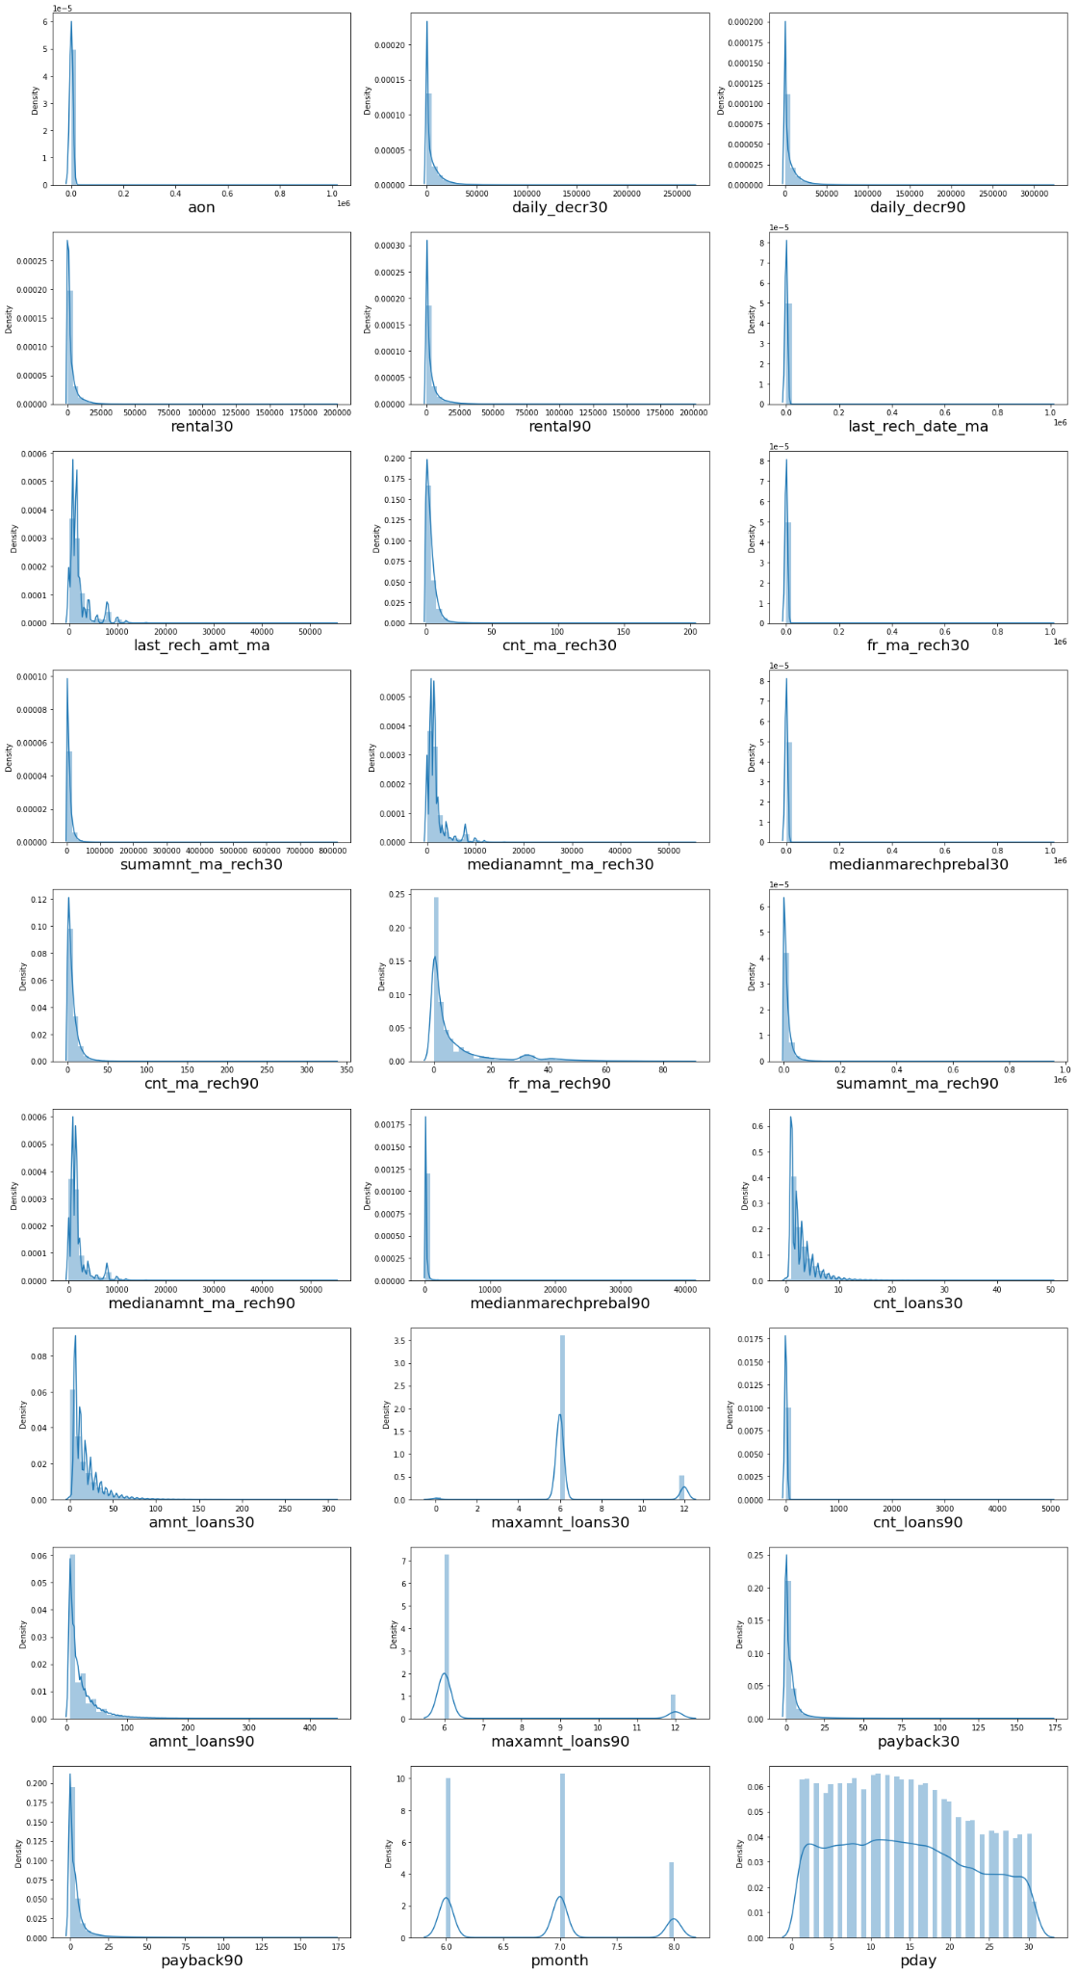
OBSERVATION: We can see skewness present in most of the columns above, we will have to treat skewness before model building.

Slide 13
OBSERVATION: We can see skewness present in most of the columns above, we will have to treat skewness before model building.

Slide 14
OBSERVATION: We can see skewness present in most of the columns above, we will have to treat skewness before model building.

Slide 15
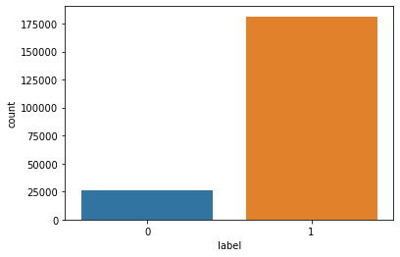
OBSERVATION: We can see that there are more successes (1) compared to failures (0) in repayment of the loan.

Slide 16
BIVARIATE ANALYSIS :
Since all the columns are numerical and there are no categorical columns present in the dataset, we shall use bar plot to visualize the numerical columns.
Here, we are using the bar plot to see the relation between the target and the other features.
I found that in maximum features the count of non-defaulters is high compared to defaulters so the risk is less comparatively.

Slide 17
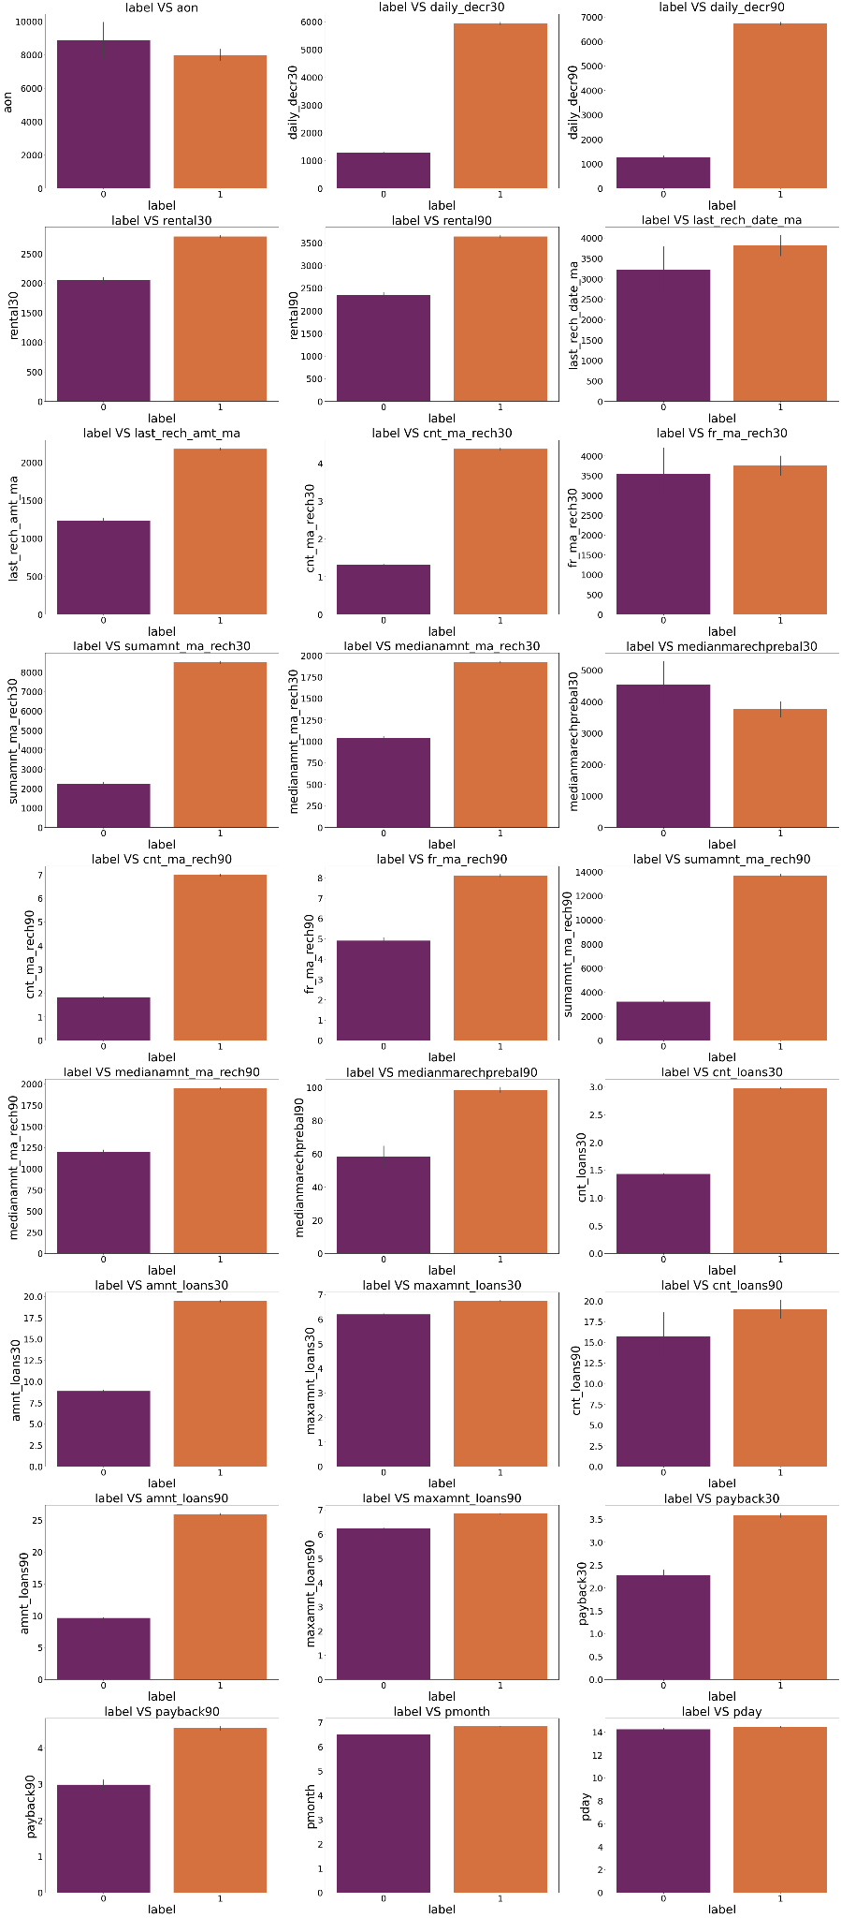

Slide 18
OBSERVATIONS :
Customers with higher Age on cellular network in days(aon) are maximum defaulters (who have not paid their loan amount-0).
Customers with a high value of Daily amount spent from the main account, averaged over the last 30 days (in Indonesian Rupiah)(daily_decr30) are maximum. Non-defaulters(who have paid their loan amount-1).
Customers with a high value of Daily amount spent from the main account, averaged over the last 90 days (in Indonesian Rupiah)(daily_decr90) are maximum. Non-defaulters (who have paid their loan amount-1).
Customers with a high value of Average main account balance over the last 30 days(rental30) are maximum. Non-defaulters(who have paid their loan amount-1).
Customers with a high value of Average main account balance over the last 90 days(rental90) are maximum. Non-defaulters(who have paid their loan amount-1).

Slide 19
OBSERVATIONS :
Customers with a high Number of days till the last recharge of the main account(last_rech_date_ma) are maximum. Non-defaulters(who have paid their loan amount-1).
Customers with a high value of the last recharge of the main account (in Indonesian Rupiah)(last_rech_amt_ma) are maximum. Non-defaulters(who have paid their loan amount-1).
Customers with a high value of Number of times the main account got recharged in the last 30 days(cnt_ma_rech30) are maximum. Non-defaulters(who have paid their loan amount-1).
Customers with high value of Frequency of main account recharged in last 30 days(fr_ma_rech30) are maximum. Non-defaulters(who have paid their loan amount-1) and also the count is high for defaulters comparatively. Non-defaulters are more in number.

Slide 21
OBSERVATIONS :
Customers with a high value of Total amount of recharge in the main account over the last 30 days (in Indonesian Rupiah)(sumamnt_ma_rech30) are maximum. Non-defaulters(who have paid their loan amount-1).
Customers with a high value of Median of the amount of recharges done in the main account over the last 30 days at user level (in Indonesian Rupiah)(medianamnt_ma_rech30) are maximum. Non-defaulters(who have paid their loan amount-1).
Customers with a high value of Median of main account balance just before recharge in the last 30 days at user level (in Indonesian Rupiah)(medianmarechprebal30) are maximum defaulters(who have not paid their loan amount-0).
Customers with a high value of Number of times the main account got recharged in the last 90 days(cnt_ma_rech90) are maximum. Non-defaulters(who have paid their loan amount-1).

Slide 22
OBSERVATIONS :
Customers with high value of Frequency of main account recharged in last 90 days(fr_ma_rech90) are maximum. Non-defaulters(who have paid their loan amount-1).
Customers with a high value of Total amount of recharge in the main account over the last 90 days (in Indonesian Rupiah)(sumamnt_ma_rech90) are maximum. Non-defaulters(who have paid their loan amount-1).
Customers with a high value of Median of the amount of recharges done in the main account over the last 90 days at user level (in Indonesian Rupiah)(medianamnt_ma_rech90) are maximum. Non-defaulters(who have paid their loan amount-1).

Slide 23
OBSERVATIONS :
Customers with a high value of Median of main account balance just before recharge in the last 90 days at user level (in Indonesian Rupiah)(medianmarechprebal90) are maximum. Non-defaulters(who have paid their loan amount-1).
Customers with a high value of Number of loans taken by the user in the last 30 days(cnt_loans30) are maximum. Non-defaulters(who have paid their loan amount-1).

Slide 25
OBSERVATIONS :
Customers with a high value of Total amount of loans taken by the user in the last 30 days(amnt_loans30) are maximum. Non-defaulters(who have paid their loan amount-1).
Customers with a high value of the maximum amount of loan taken by the user in the last 30 days(maxamnt_loans30) are maximum. Non-defaulters(who have paid their loan amount-1).
Customers with a high value of Number of loans taken by the user in the last 90 days(cnt_loans90) are maximum. Non-defaulters(who have paid their loan amount-1).
Customers with a high value of Total amount of loans taken by the user in the last 90 days(amnt_loans90) are maximum. Non-defaulters(who have paid their loan amount-1).

Slide 26
OBSERVATIONS :
Customers with a high value of maximum amount of loan taken by the user in the last 90 days(maxamnt_loans90) are maximum. Non-defaulters(who have paid their loan amount-1).
Customers with a high value of Average payback time in days over the last 30 days(payback30) are maximum. Non-defaulters(who have paid their loan amount-1).
Customers with a high value of Average payback time in days over the last 90 days(payback90) are maximum. Non-defaulters(who have paid their loan amount-1).
In between 6th and 7th month maximum customers both defaulters and Non-defaulters have paid their loan amount.
By the 14th of each month all the customers have paid their loan amount.

Slide 27
Analysis.
Firstly, from the problem statement we got to know that it is a Classification problem for which we will be using Classification algorithms to build the model and predict the defaulters level.
Secondly, from the distribution plots and box plots I found skewness and outliers in almost all the columns. Also, based upon the analysis and visualization part we have seen some of the features having linear relation with label. So, I assumed these features helps in model building and to predict the defaulters and non-defaulters level in the organizations.
So, I suggest that the financial institutions take into consideration the features that were deemed as most important as seen in this study might help them estimate the defaulters level.

Slide 28
Data Cleaning Steps.
I have done feature engineering steps like feature extraction and feature selection to improve data normality and linearity.
Identified outliers using boxplots and removed outliers using percentile method.
Identified skewness using distribution plots and removed skewness using power transformation method (yeo-johnson method).
Used Pearson’s correlation coefficient to check the correlation between dependent and independent variables. To visualize the correlation I have used heatmap and bar plot.
I have used MinMaxScaler method to scale the data to overcome with the issue of data biasness.

Slide 29
Data Cleaning Steps.
Balanced the data using SMOTE oversampling mechanism.
Split train and test to build machine learning models. Model building process will be shown in the further steps.

Slide 30
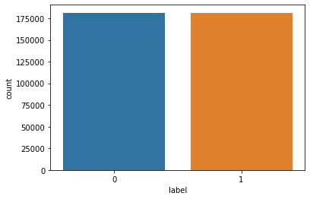
Data Balancing.
Which checking the value counts of our target “ label ”, I found a lot of imbalance in the data. I have used oversampling (SMOTE) to get rid of data imbalancing. The balanced output looks like this :

Slide 31
Model Building.
In this problem label is our target variable which is categorical in nature that is the Label ‘1’ indicates that the loan has been paid i.e., “non-defaulter”, while, Label ‘0’ indicates that the loan has not been paid i.e., “defaulter”. From this I can conclude that it is a Classification type problem hence I have used following regression algorithms.
After the pre-processing and data cleaning I left with 27 columns including target and with the help of feature importance bar graph I used these independent features for model building and prediction.

Slide 32
Model Building.
The algorithms used on training the data are as follows:
Logistic Regression Model.
Decision Tree Classifier.
Random Forest Classifier.
Extra Trees Classifier.
Bagging Classifier.
XGBoost Classifier.
I have got the best ransom state and maximum R2 score and then created train test split to build the above models.

Slide 33
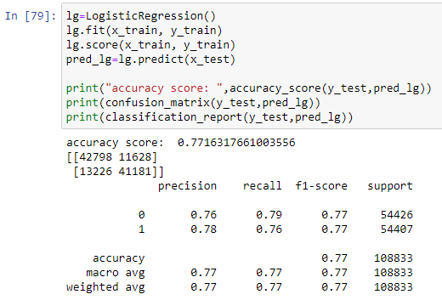
Logistic Regression Model.
The Logistic Regression model gave us an accuracy score of 77.16 %.

Slide 34
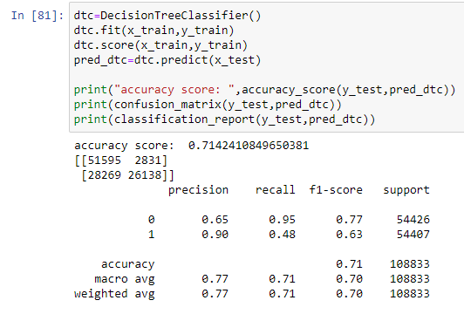
Decision Tree Classifier Model.
The Decision Tree Classifier Model gave us an accuracy Score of 71.42 %.

Slide 35
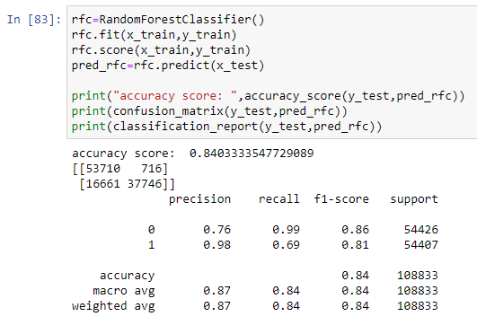
Random Forest Classifier Model.
The Random Forest Classifier model gave us an accuracy Score of 84.03 %.

Slide 36
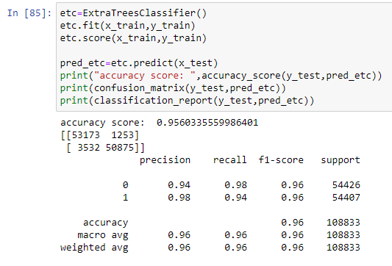
Extra Trees Classifier Model.
The Extra Trees Classifier model gave us an accuracy Score of 95.60%.

Slide 37
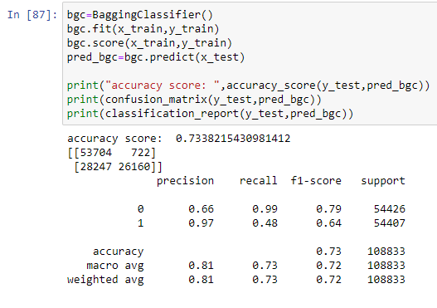
Bagging Classifier Model.
The Bagging Classifier model gave us an accuracy Score of 73.38 %.

Slide 38
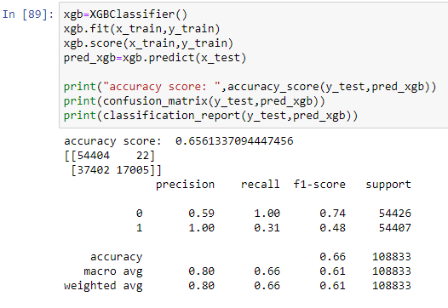
XGBoost Classifier Model.
The XGBoost Classifier model gave us an accuracy Score of 65.61 %.

Slide 39
Analysis of Models.
From the above Classification Models, the highest accuracy score belongs to Extra Trees Classifier.
Next, the Random Forest Classifier, followed by Logistic Regression Model & Bagging Classifier.
After that, the Decision Tree Classifier.
Lastly, the XGBoost Classifier.

Slide 40
Cross Validation Scores.
The cross validation score of the Logistic Regression Model is 77.16 %.
The cross validation score of the Decision Tree Classifier Model is 90.99 %.
The cross validation score of the Random Forest Classifier Model is 94.96 %.
The cross validation score of the Extra Trees Classifier Model is 96.30 %.
The cross validation score of the Bagging Classifier Model is 93.61 %.
The cross validation score of the XGBoost Classifier Model is 93.67 %.

Slide 41
Cross Validation Scores.
The highest cross validation score belongs to the Extra Trees Classifier, followed by the Random Forest Classifier.
Next the XGBoost Classifier and the Bagging Classifier.
After that, the Decision Tree Classifier.
Lastly, the lowest Cross Validation Score belongs to the Logistic Regression Model.

Slide 42
Hyper Parameter Tuning.
Since the Accuracy score and the cross validation score of the Extra Trees Classifier are the highest we shall consider it for hyper parameter tuning.
We shall use GridSearchCV for Hyper Parameter Tuning.
After multiple tries with hyper parameter tuning, the highest accuracy score obtained was 91.58 %.

Slide 43
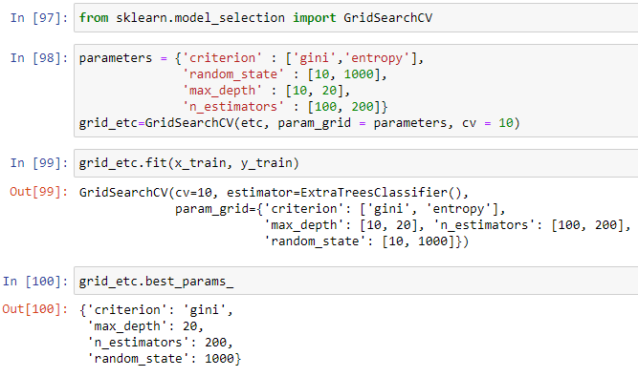
Hyper Parameter Tuning.

Slide 44
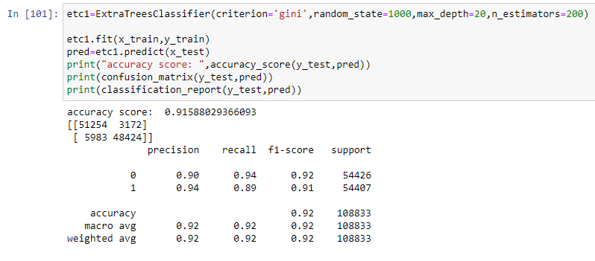
Hyper Parameter Tuning.
After hyper parameter tuning, the accuracy score obtained was 91.58 %.

Slide 45
Hyper Parameter Tuning.
After hyper parameter tuning, the accuracy score obtained was 91.58 %.

Slide 46
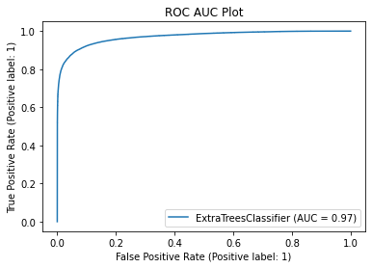
ROC - AUC Curve.
We have plotted the ROC-AUC curve, AUC score is 97 %.

Slide 47
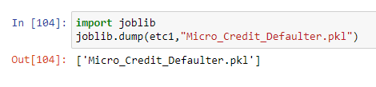
Saving the model.
The Extra Trees Classifier Model is our best model with accuracy score of 91.58 %.

Slide 48
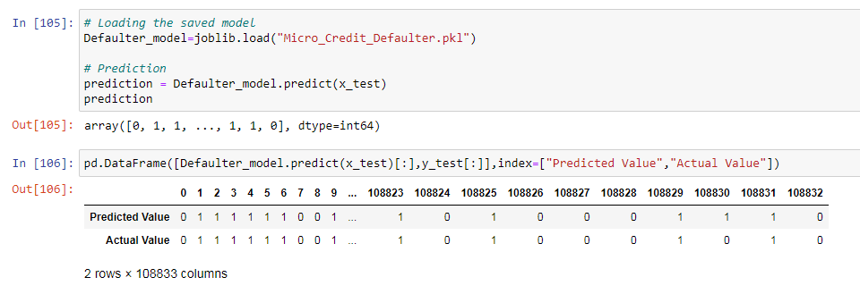
Prediction.
The actual and predicted values are almost similar.

Slide 49
Conclusion.
This case study aims to give an idea of applying EDA in a real business scenario. In this case study, apart from applying the techniques that we have learnt in the EDA, we will also develop a basic understanding of risk analytics in banking and financial services and understand how data is used to minimize the risk of losing money while lending to customers.
From this dataset we were able to understand that the selection of customers for the credit to know whether they are defaulters or non-defaulters are done on the basis of different features.
First, we loaded the dataset and have done data cleaning and EDA process and pre-processing techniques like checking outliers, skewness, correlation, scaling data etc. And got better insights from data visualization.

Slide 50
Conclusion.
Then we did the model training, building the model and finding out the best model on the basis of different metrics like Accuracy Score, Cross Validation Score, roc-auc curve, precision, recall, f1-score etc.
We used 6 different classification algorithms including Logistic Regression model, XGBoost Classifier and Decision Tree Classifier Model. We also tried ensemble techniques like Random Forest Classifier, Extra Trees Classifier, Bagging Classifier etc.
We got Extra Trees Classifier as the best model among all the models as it gave least difference of accuracy and cross validation score. On this basis we performed the Hyperparameter tuning to finding out the best parameters. The accuracy score did not increase after tuning but it was still a good score.

Slide 51
Conclusion.
After that we saved the model in a pickle with a filename in order to use whenever we require. Then we loaded the saved file and predicted the values.
Overall, we can say that this dataset is good for predicting the defaulters level using classification analysis and conclude that Extra Trees Classifier is the best working algorithm model we obtained. We can improve the data by adding some more features.

